Slide 1
mini – project
Internal Guide: Prof. Deepti Vijay Chandran
GROUP NO : G8
Group Members :
Name of the student | Roll. No of the student
Aryan Lagalwar | 32
Dikshita Padte | 41
Ekta Vayanan | 74

Slide 2
Topics of mini – project :
1. River Water Quality Modelling using Artificial Neural Network Technique
2. FACE RECOGNITION UDING DL
3. Irrigation Monitoring Using Artificial Neural Network

Slide 3

River Water Quality Modelling using Artificial Neural Network Technique
Dissolved oxygen (DO) is a primary indicator of the river water quality and has received lot of attention in the literature in recent past. The resultant DO concentration at any location in a river is the result of many processes occurring at the upstream location, which include, de-oxygenation, re-aeration, photosynthesis, respiration, sediment oxygen demand, water temperature and the discharge. The two cities namely, Mathura and New Delhi, located at the at the bank of River Yamuna in Uttar Pradesh and Delhi, India, discharge significant amount of municipal and industrial waste to the River Yamuna without prior treatment in most of the cases. The quality of the River Yamuna has been sinking in recent past.
For prediction of dissolved oxygen in a stream under scenarios of interest, different deterministic models have been attempted in the past. However, in practice the statistical accuracy of the models commonly is poor because natural systems tend to be too complex for state of the art deterministic modelling methods. ANNs provide a quick and flexible means of creating models for estimation of stream water quality. In recent years ANNs have shown exceptional performance as regression tools.
The problem of water quality management plays an important role in water pollution control and river basin planning. In this paper, ANNs are applied for simulating the DO values in River Yamuna at the downstream of Mathura city, which is receiving tremendous amount of municipal and industrial wastes from the urban area and non-point source pollutants from its surroundings. The architecture of ANN used in the present work are discussed in the next section.

Slide 4
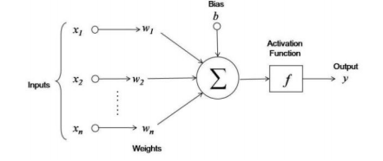
Architecture of artificial neural network: The terminology of ANN is developed from the biological model of the brain. A neural network consists of a set of connected cells, which is called the neurons. The neurons receive impulses from either input cells or other neurons and perform some kind of transformation of the input and transmit the outcome to the neurons or to output cells. The neural networks are built from layers of neurons connected so that one layer receives input from the preceding layer of neurons and passes the output on the subsequent layer. According to [11], the data fed through the input layer is scaled by an initial weighting through the connecting between neurons. The relationship between inputs (x), weights (w) and outputs (y) as shown in figure. An ANN stores the knowledge about the problem in terms of weights of inter-connections. The process of determining ANN weights is called learning or training.

Slide 5


Methodology of ann
3.1 Input Selection: The total of 100 data set from excel file was imported from excel file to develop the ANN model. Six parameters that had been collected were used in this input selection and five categories classes based on water quality standard were set as a target variables to produce an output.
3.2 Data Pre-processing : Normalization procedure before presenting the input data to the network is required since mixing variables with large magnitudes and small magnitudes will confuse the learning algorithm on the importance of each variable and may force it to finally reject the variable with the smaller magnitude. Normalization will scale the minimum value to 0 and maximum value to 1.
3.3 Training and testing network: In order to train and test the network, experimental data was categorized into two sets which were for training and testing sets. The training set was used to identify the biases and weight of the network. Meanwhile the testing set was used for calibration to prevent the overtraining of the network and could be used to measure the performance of the network.
3.4 Modelling : The algorithm of the neural network was used to train and test the data set. All the testing was recorded into the network to make it learn the potential relationship between water quality parameter and their corresponding categories. Six parameters represented the input layer nodes of the ANN model.
Percentages of classification accuracy and root mean square error (RMSE) was used to represent the performance of ANN as shown in Equation (1). The lower the RMSE, the more accurate is the estimation. In order to speed up the training process and maintain the error reduction, the hidden layer, momentum and learning rate were adjusted.

Slide 6
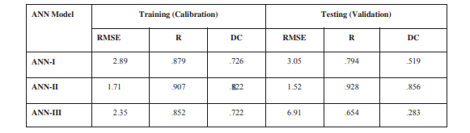
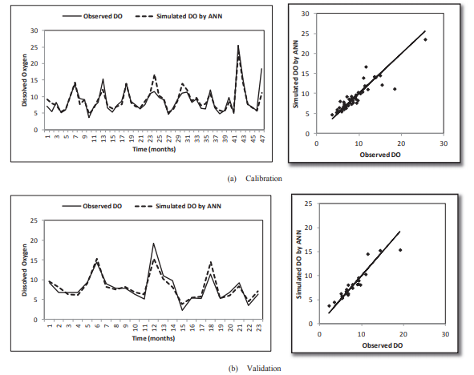
the above diagrams indicate the table and graphical representation of testing and training data

Slide 7
Conclusion
Very limited efforts have been made in the past specifically in India to utilise ANN for water quality modelling purposes. It is understood that the estimation of water quality of a river at any location is a tedious work due to the non-linear behaviour of different water quality variables. The ANNs have been successfully used in many hydrological studies and this was a motivating factor for its application to the present study. The performance of ANN was tested using RMSE, R and DC. It was found that the ANN approach turned out to be an efficient approach for water quality modelling. Even more accurate predictions of DO could be obtained with a shorter time base input data, e.g., 10-daily or daily data. An added advantage of ANN is that it does not require any assumption about the range of flow discharge, temperature, BOD and DO. However, the input data should be consistent and the controlling factors should be the same for training and test data.

Slide 8
Face recognition using dl
Step 1: Finding all the Faces
The first step in our pipeline is face detection. Obviously we need to locate the faces in a photograph. Face detection is a great feature for cameras. When the camera can automatically pick out faces, it can make sure that all the faces are in focus before it takes the picture. But we’ll use it for a different purpose finding the areas of the image we want to pass on to the next step in our pipeline.
To find faces in an image, we’ll start by making our image black and white because we don’t need colour data to find face, Then we’ll look at every single pixel in our image one at a time. For every single pixel, we want to look at the pixels that directly surrounding it

Slide 9
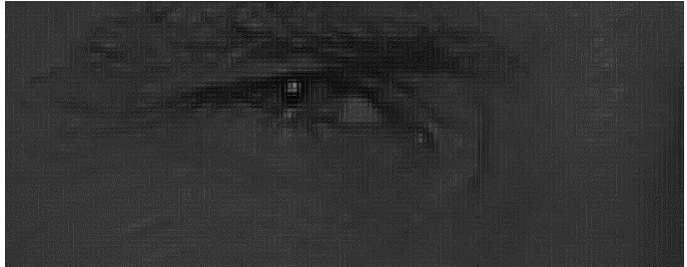
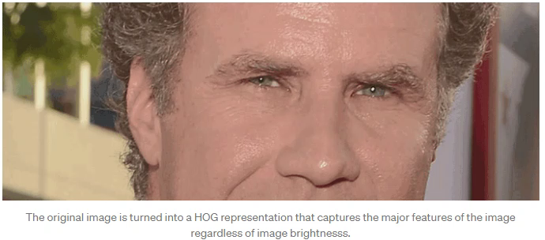
If we analyze pixels directly, really dark images and really light images of the same person will have totally different pixel values.
To do this, we’ll break up the image into small squares of 16x16 pixels each. In each square, we’ll count up how many gradients point in each major direction.
The end result is we turn the original image into a very simple representation that captures the basic structure of a face in a simple way
Our goal is to figure out how dark the current pixel is compared to the pixels directly surrounding it. Then we want to draw an arrow showing in which direction the image is getting darker.
If you repeat that process for every single pixel in the image, you end up with every pixel being replaced by an arrow. These arrows are called gradients and they show the flow from light to dark across the entire image

Slide 10
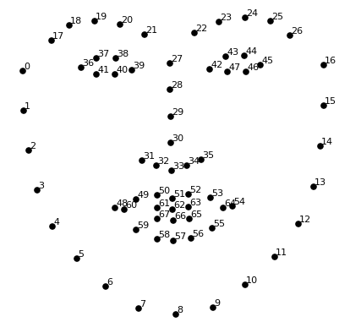
Step 2: Posing and Projecting Faces
Whew, we isolated the faces in our image. But now we have to deal with the problem that faces turned different directions look totally different to a computer. To account for this, we will try to warp each picture so that the eyes and lips are always in the sample place in the image. This will make it a lot easier for us to compare faces in the next steps.
To do this, we are going to use an algorithm called face landmark estimation.
The basic idea is we will come up with 68 specific points (called landmarks) that exist on every face — the top of the chin, the outside edge of each eye, the inner edge of each eyebrow, etc. Then we will train a machine learning algorithm to be able to find these 68 specific points on any face.

Slide 11
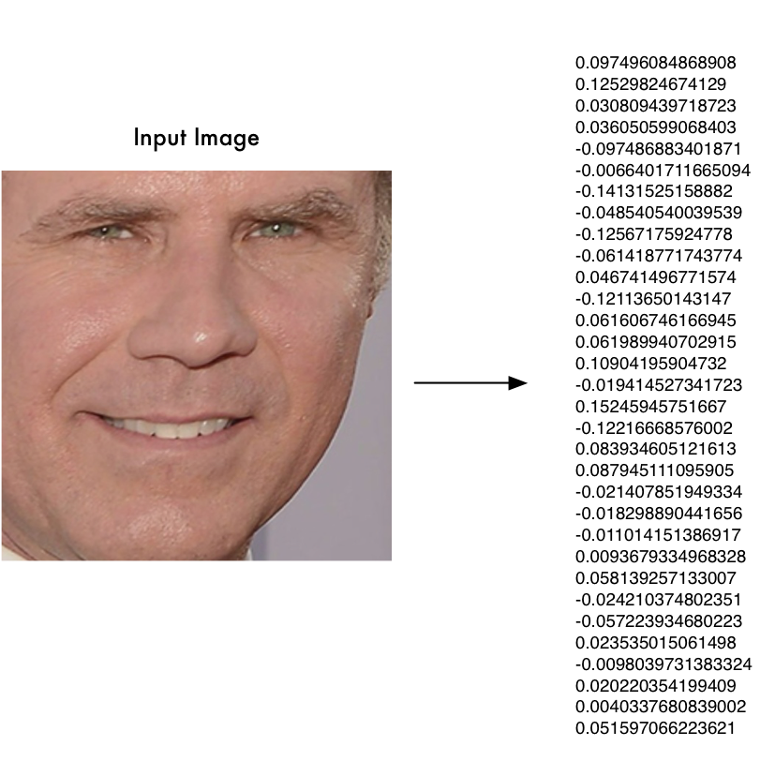
Step 3: Encoding Faces
The training process works by looking at 3 face images at a time:
Load a training face image of a known person
Load another picture of the same known person
Load a picture of a totally different person.
This process of training a convolutional neural network to output face embeddings requires a lot of data and computer power. Even with an expensive NVidia Telsa video card, it takes about 24 hours of continuous training to get good accuracy.
So all we need to do ourselves is run our face images through their pre-trained network to get the 128 measurements for each face. Here’s the measurements for our test image

Slide 12
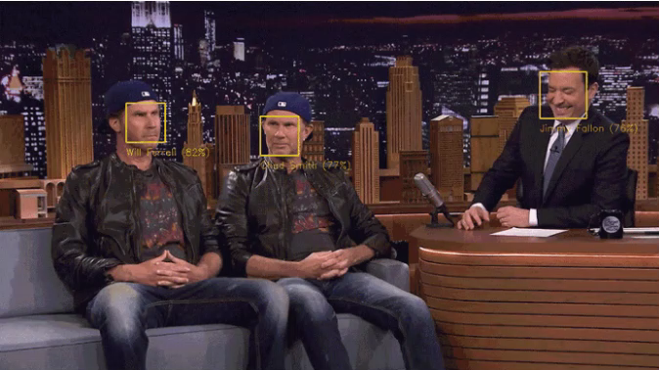
Step 4: Finding the person’s name from the encoding
This last step is actually the easiest step in the whole process. All we have to do is find the person in our database of known people who has the closest measurements to our test image.
You can do that by using any basic machine learning classification algorithm. No fancy deep learning tricks are needed. We’ll use a simple linear SVM classifier, but lots of classification algorithms could work..
All we need to do is train a classifier that can take in the measurements from a new test image and tells which known person is the closest match. Running this classifier takes milliseconds. The result of the classifier is the name of the person!

Slide 13
Irrigation Monitoring Using Artificial Neural Network

Slide 14
thank YOU

